Slide 1

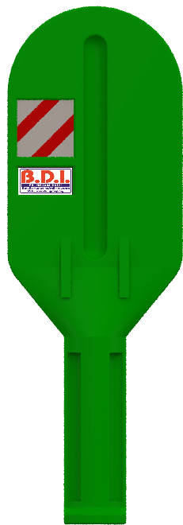
Light Barrier Small
Model Code : BDRSRBGR0027
410 MM
1335 MM
190 MM

Slide 2
Light Barrier Small
Material : High durable virgin premium grade Polyethylene material
UV Stabilized
Anti-static properties.
Can withstand the high wind pressure.
No rust, No chip, No peel.
Completely maintenance free
Provision for fixing retro-reflective sheet in an embossed position .
Pasting retro reflective sheet helps prevent vandalism, and enhances high visibility during the night.
Pedestal for proper embedding and grouting to the ground.
Can be install on the median having of size 1.2 meter or less than 1.2 meter in width.

Slide 3
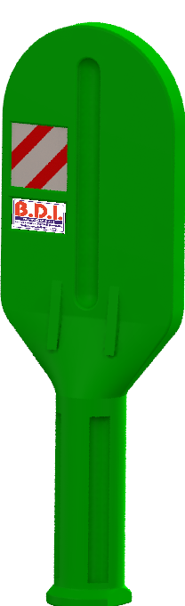
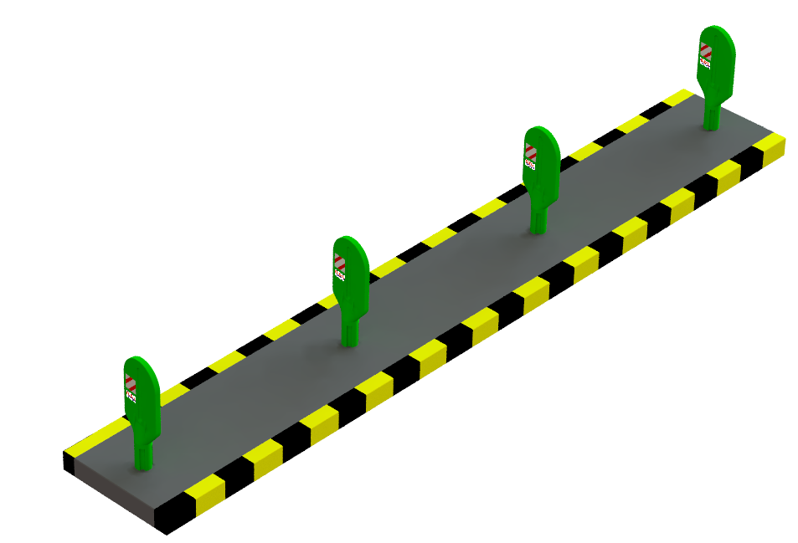
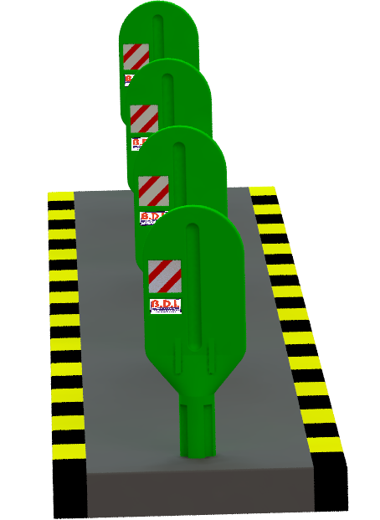
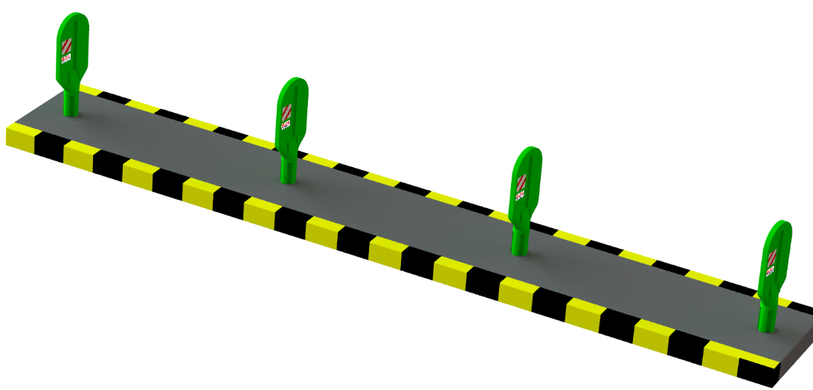

Slide 4
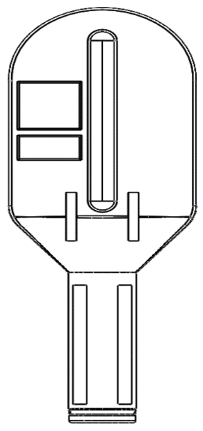
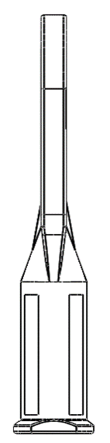
410 MM
1335 MM
190 MM
Thickness | 60mm
Width | 410mm
Height | 1335mm
Water Ballast | NA
Non Fading Color | Yes
UV Stabilized | Yes
Interlinking Provision | NA
Drain Plug | NA
Retro Reflective Color | Any
Barrier Color Availability | Green
Sticker Pasting Slot | Available
Sticker Pasting Slot Size | 220mm x 220mm

Slide 5
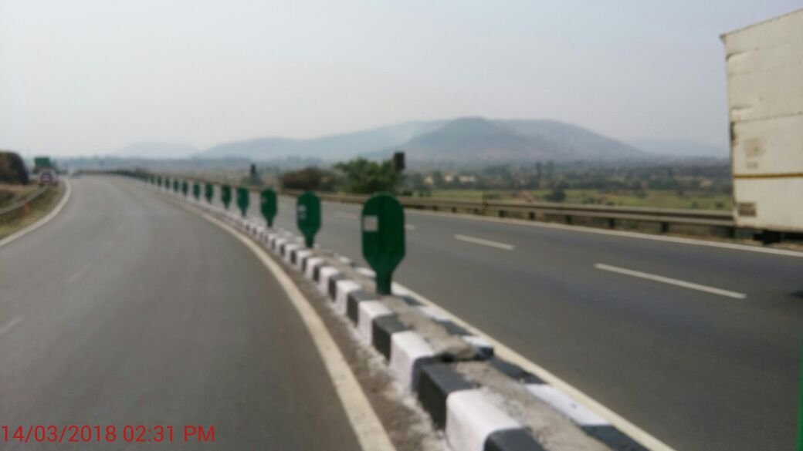
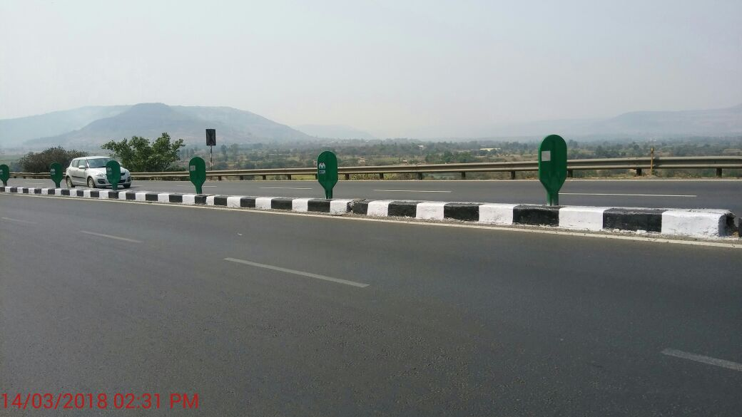
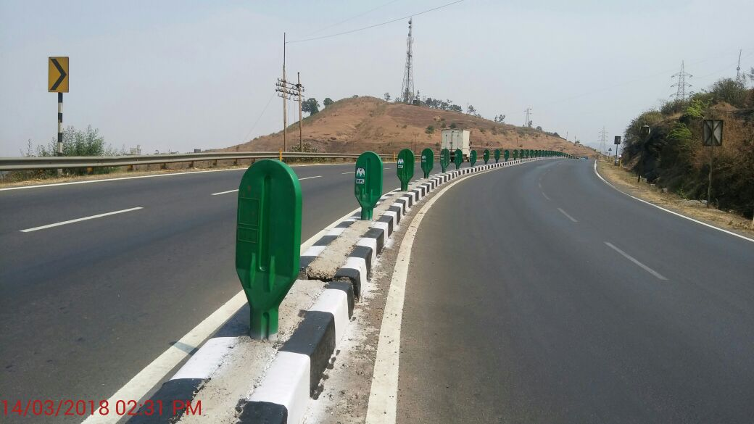
Site Photos

Slide 6
THANK YOU

