Slide 1
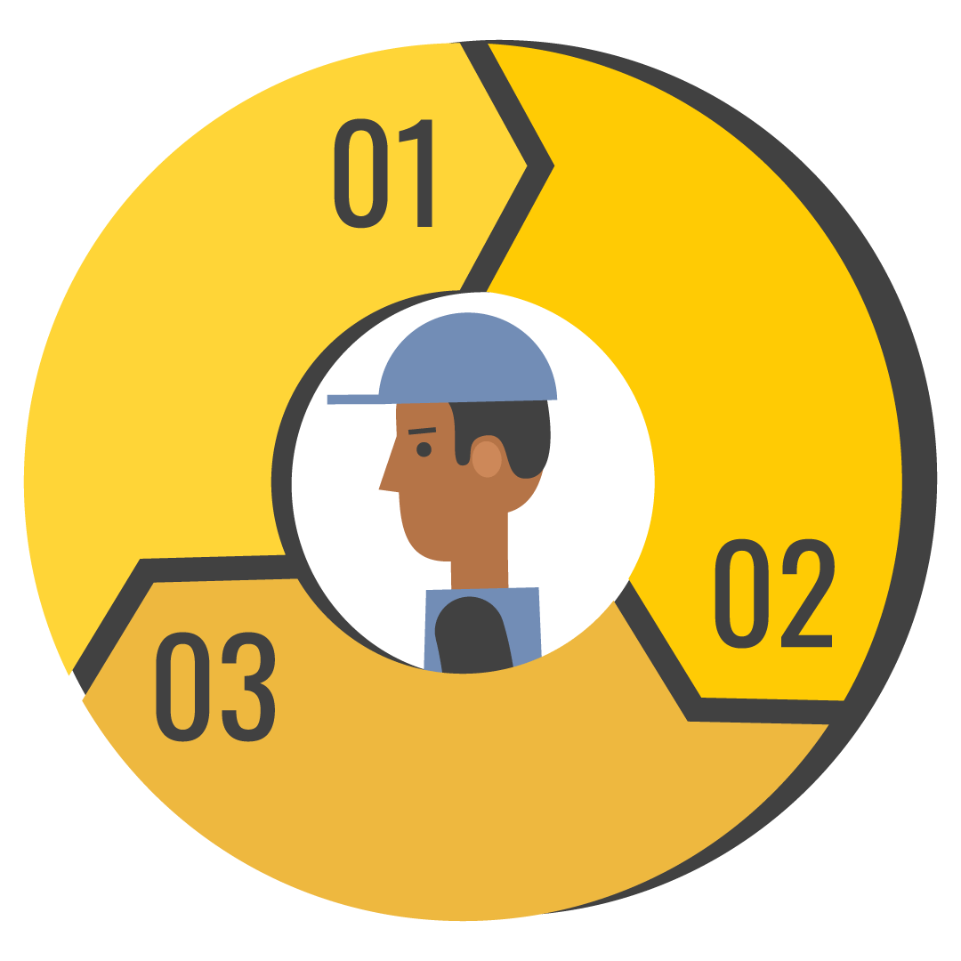
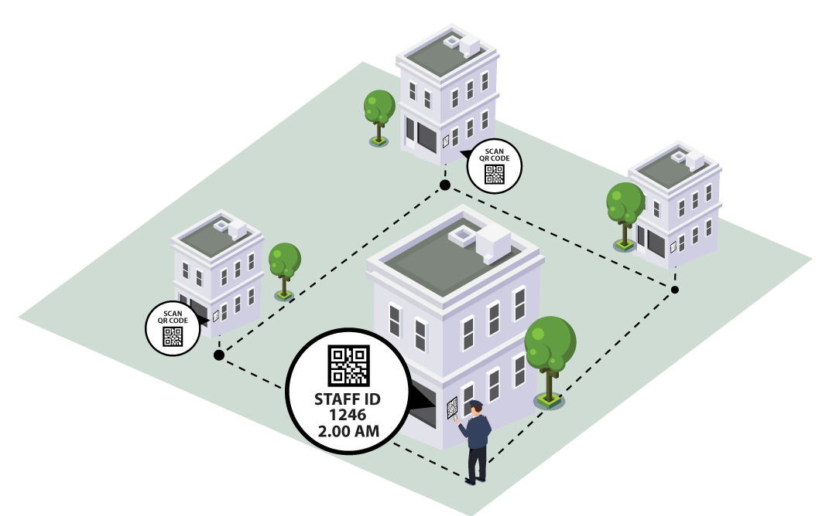
Guard Patrol Solution
VersionX OEM
VersionX 4.5.2

Slide 2
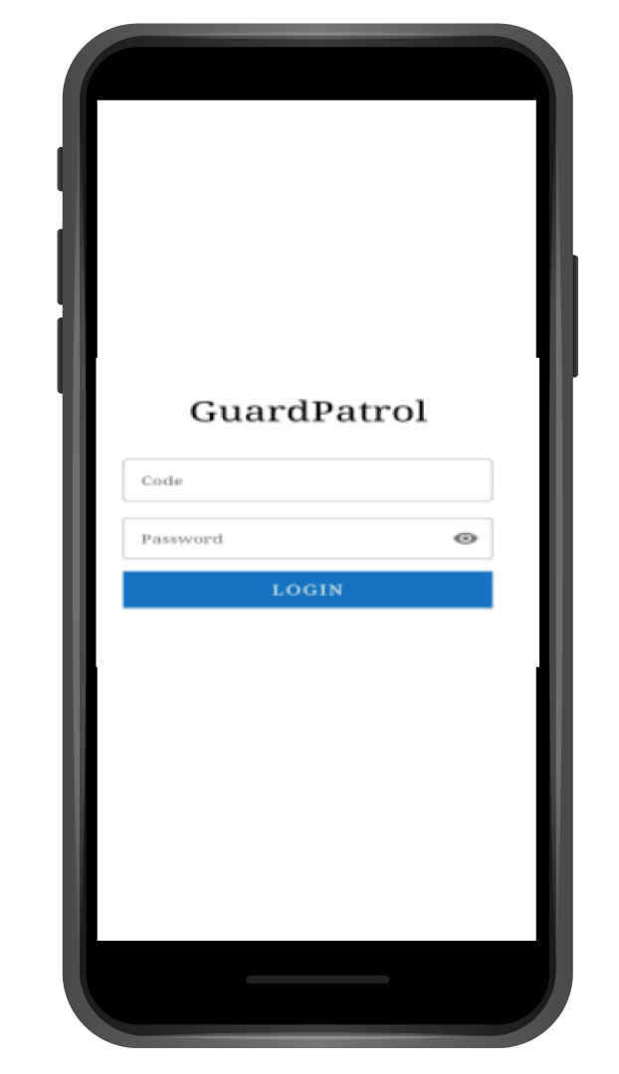
Guard Patrol Solution - Application
1 - Code Password
Enter the Code and Password provided to access the application

Slide 3
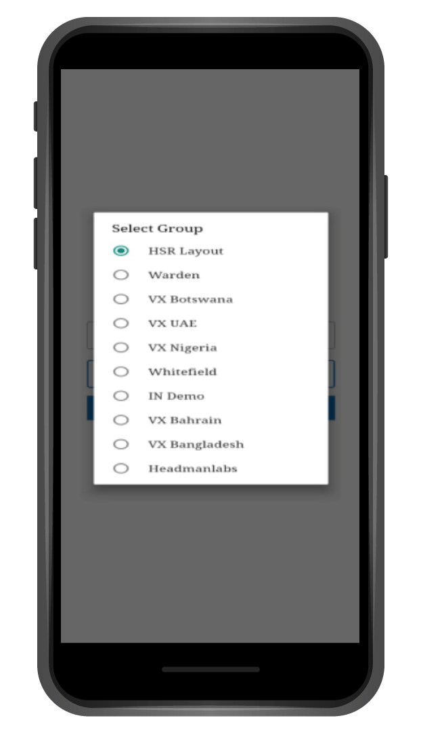
Guard Patrol Solution - Application
2 - Select Location
Select the location in case of a multi location scenario

Slide 4
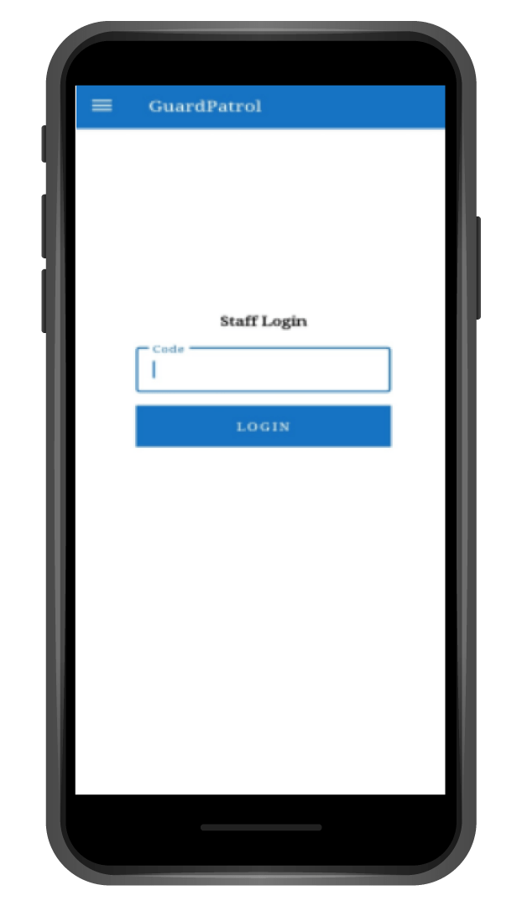
Guard Patrol Solution - Application
3 - Staff Login
The staff login will be the personal login for the guards

Slide 5
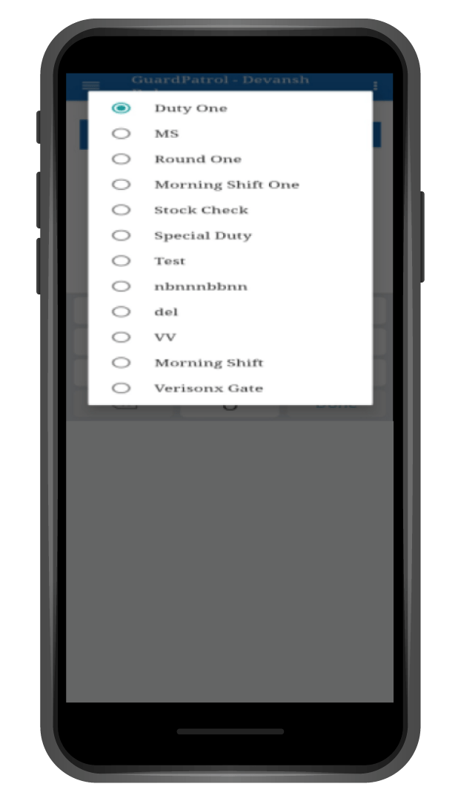
Guard Patrol Solution - Application
4 - Select Duty
The guard can select whichever duty that has been assigned to them

Slide 6
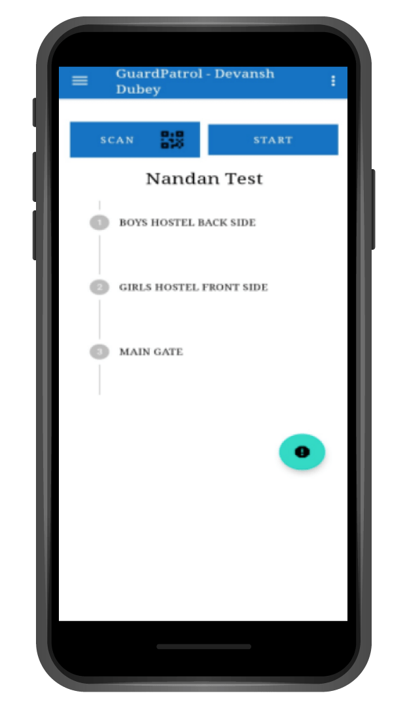
Guard Patrol Solution - Application
5 - Round Screen
The guard can now see the rounds he has to do and which checkpoints he needs to scan

Slide 7
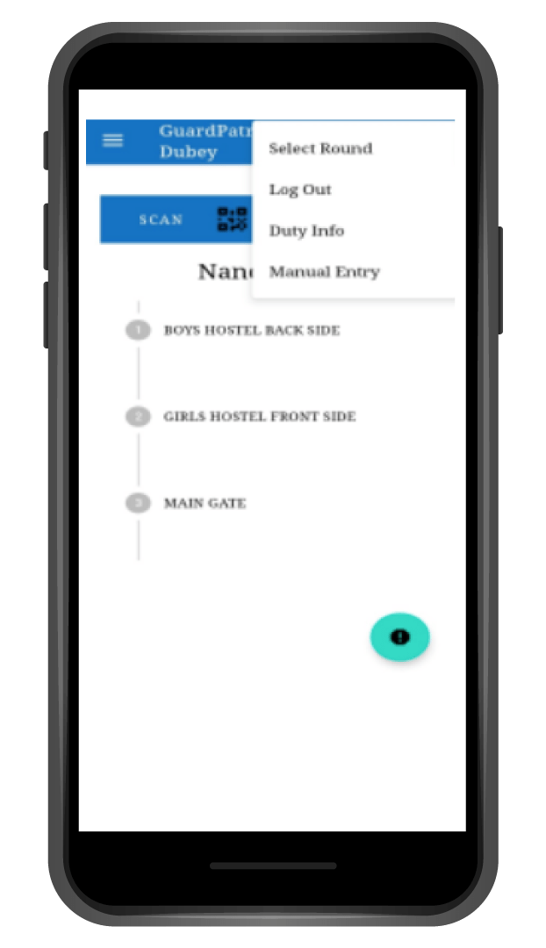
Guard Patrol Solution - Application
6 - Options Screen
The guard has option to check out round and duty information.
He can also do a manual entry incase he is unable to scan the QR code.
Also, the guard has an option to log out

Slide 8
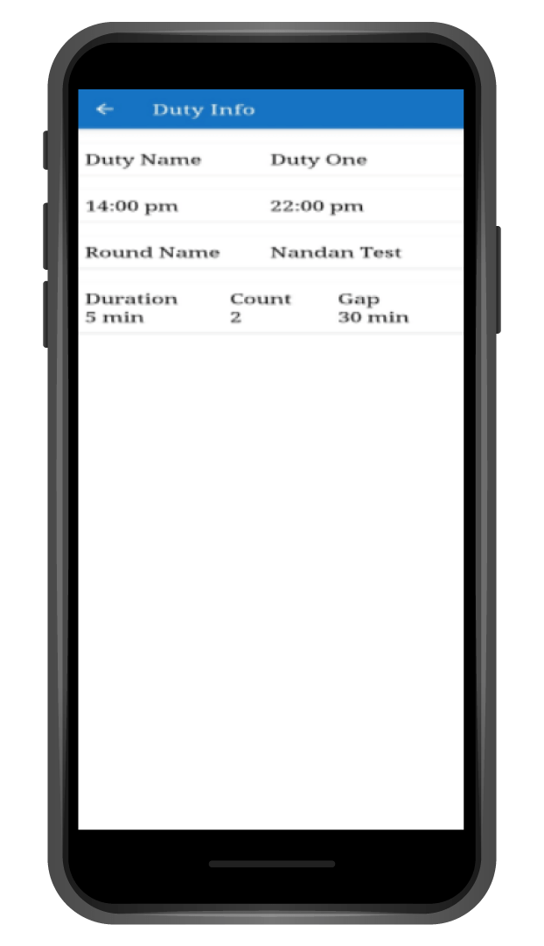
Guard Patrol Solution - Application
7 - Duty Info
The guard can see the duty information from the options on the screen

Slide 9
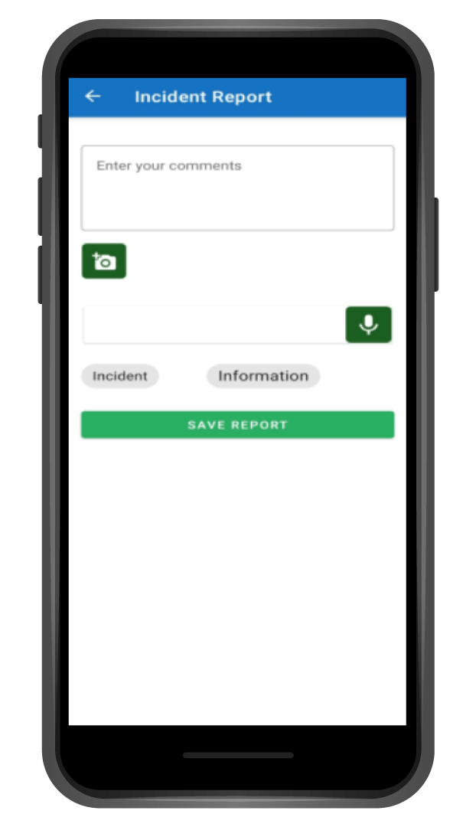
Guard Patrol Solution - Application
8 - Incident Report
In Case there is any incident to be reported the Guard can click on the Exclamation mark in the blue circle on the bottom right hand corner.
He can then write comments, Take pictures and even attach a voice note narrating the incident or information

Slide 10
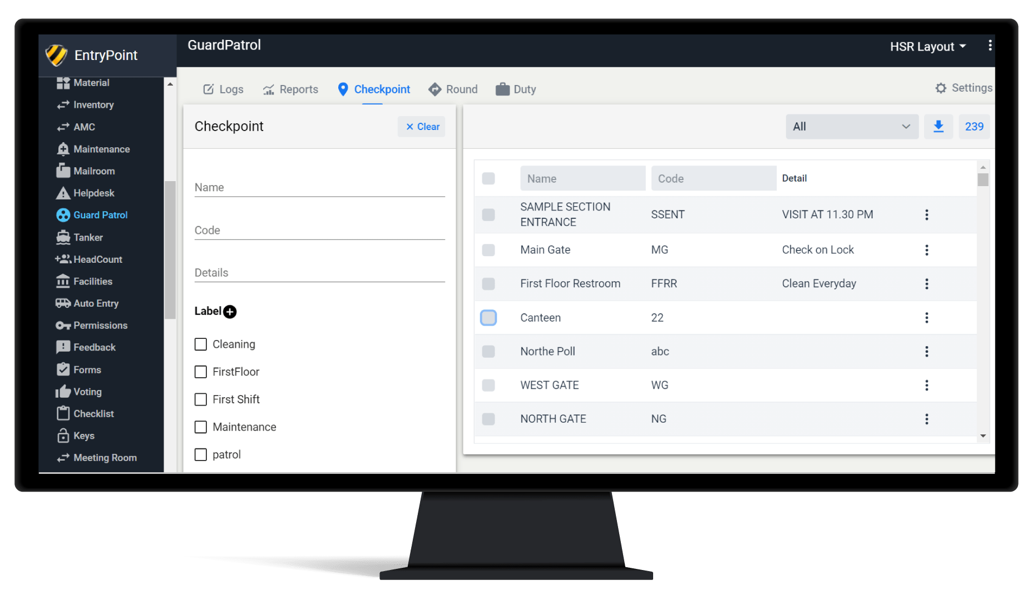
1 - Admin Creating Checkpoints
Checkpoints are areas at the location which need to be scanned to monitor the guards activities.

Slide 11
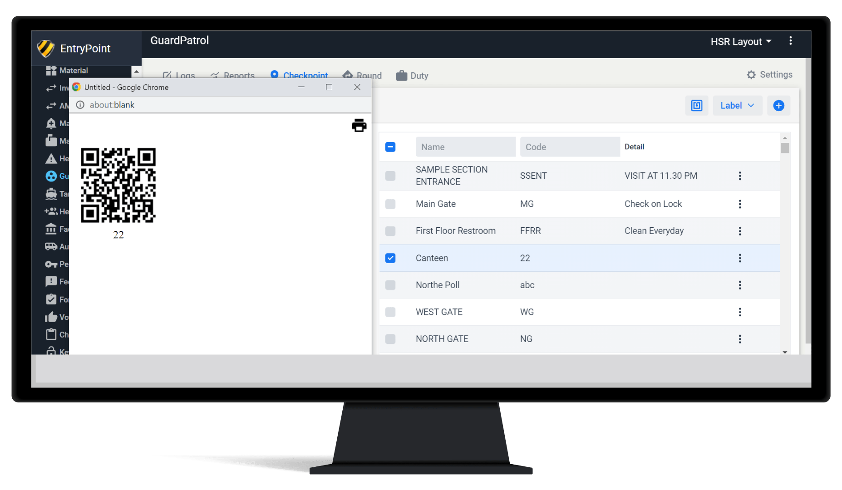
Guard Patrol Solution - Dashboard
1 - Admin Creating Checkpoints
The Admin/Security Head will create Checkpoints according to the location and Print the QR Codes generated for those checkpoints

Slide 12
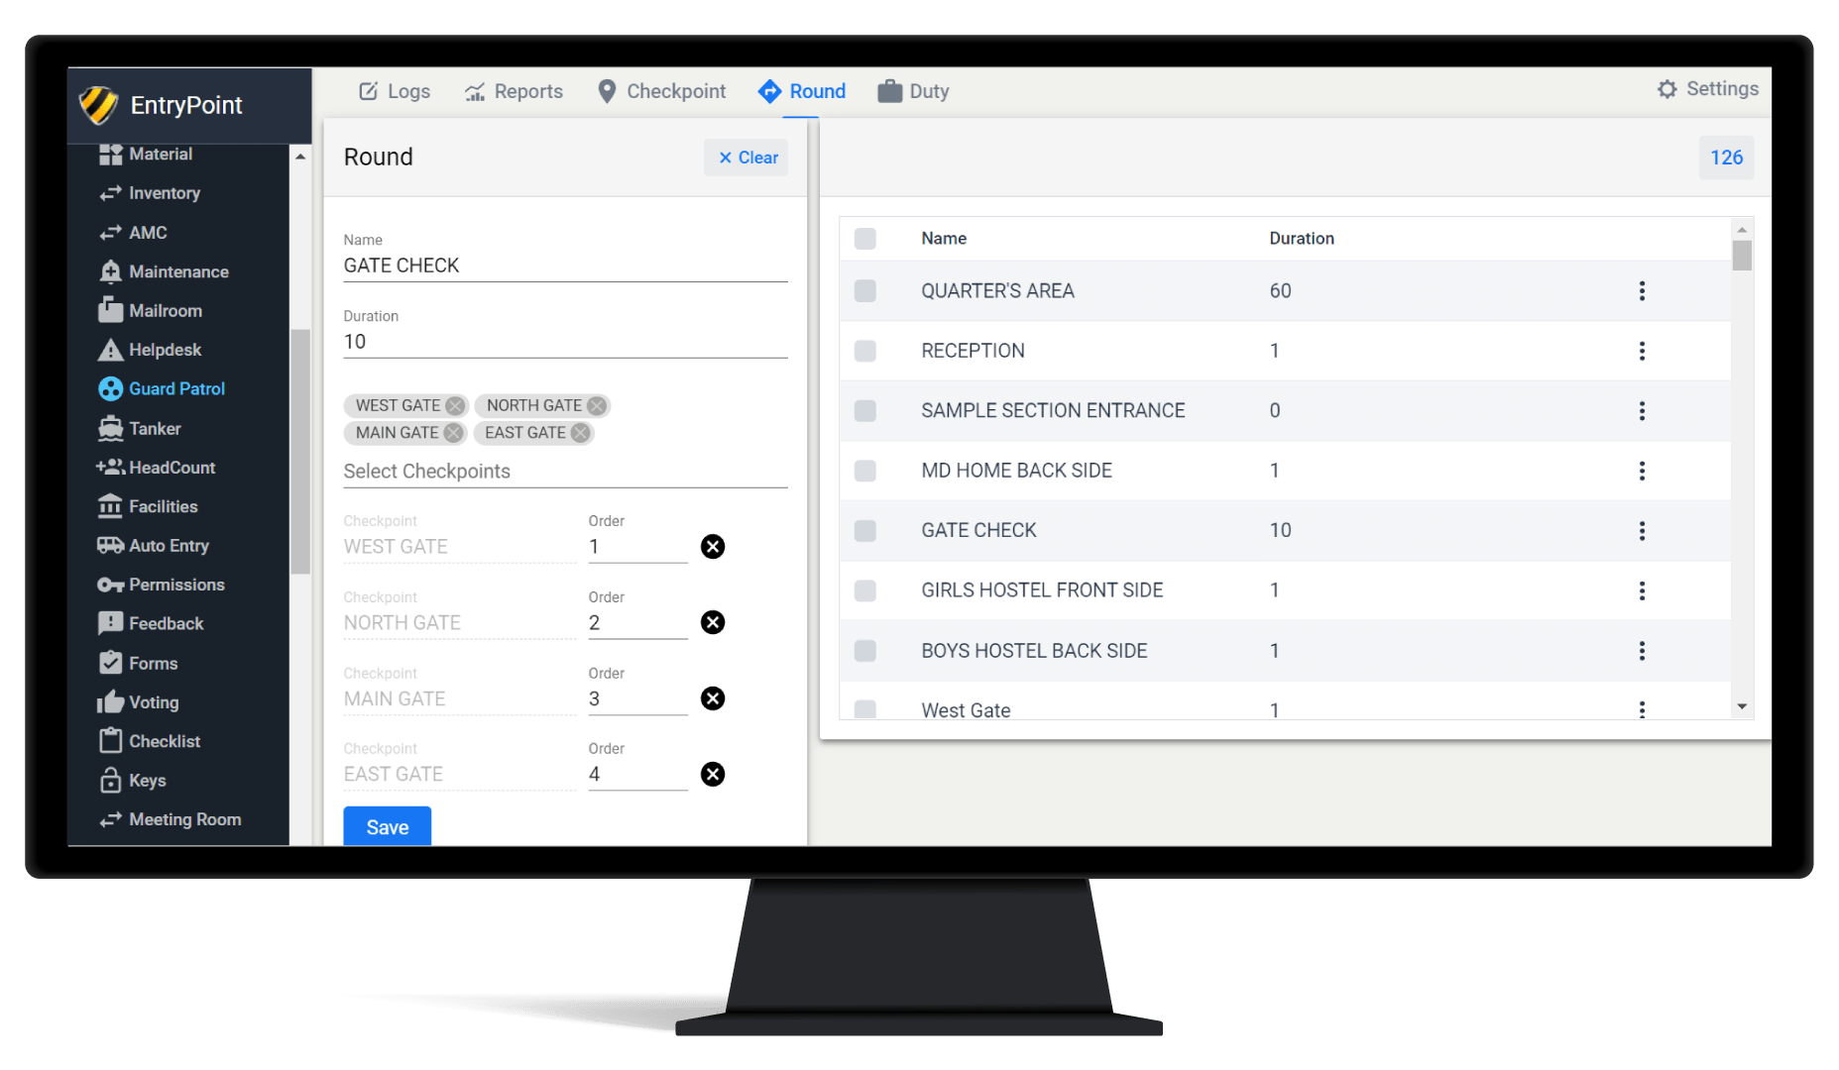
2 - Creation Of Rounds
Rounds are a compilation of multiple checkpoints.

Slide 13
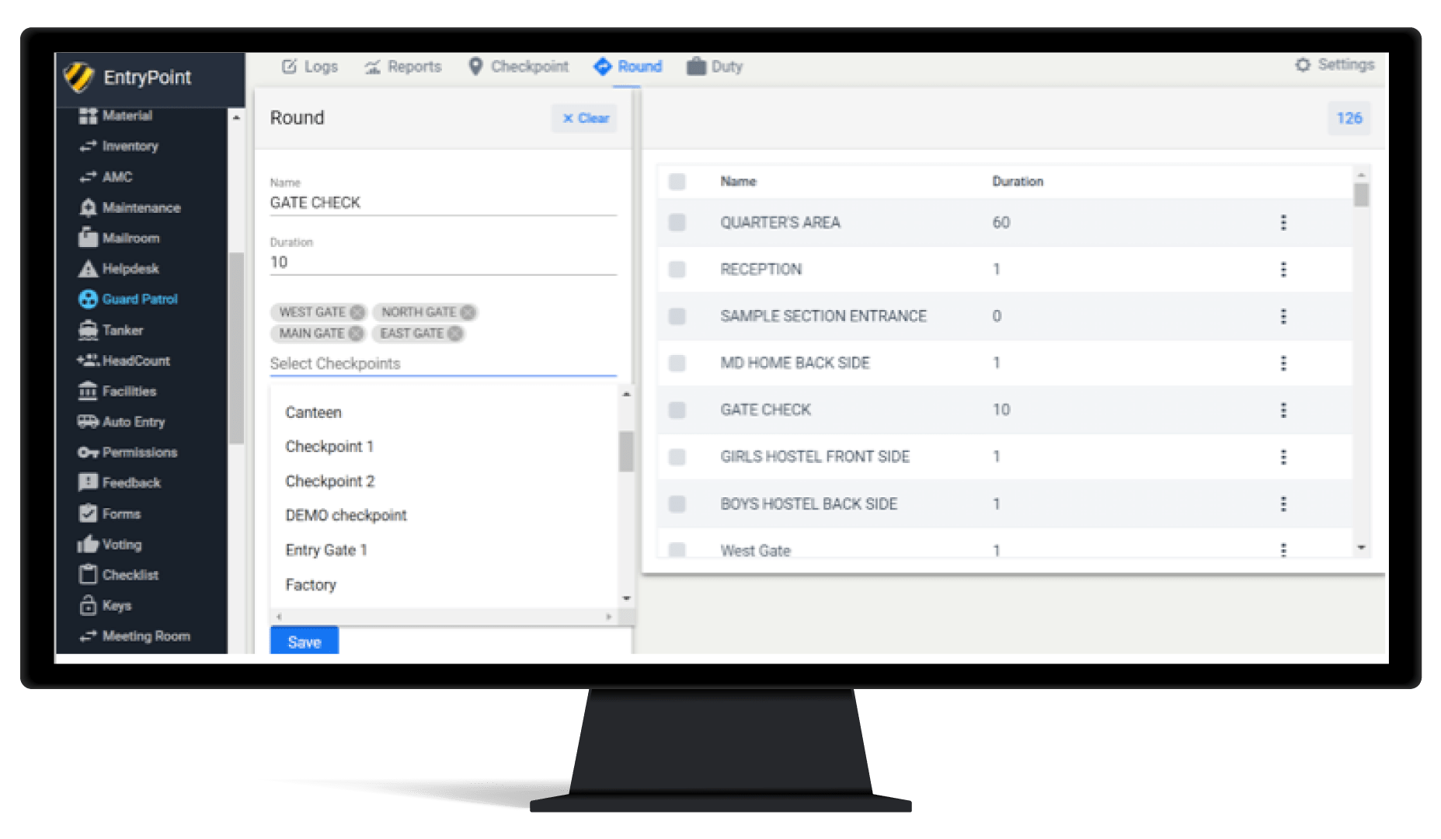
2 - Creation Of Rounds
The Admin/Security Head will Create Rounds out of the Checkpoints and can select the order of scanning of the checkpoints as well.

Slide 14
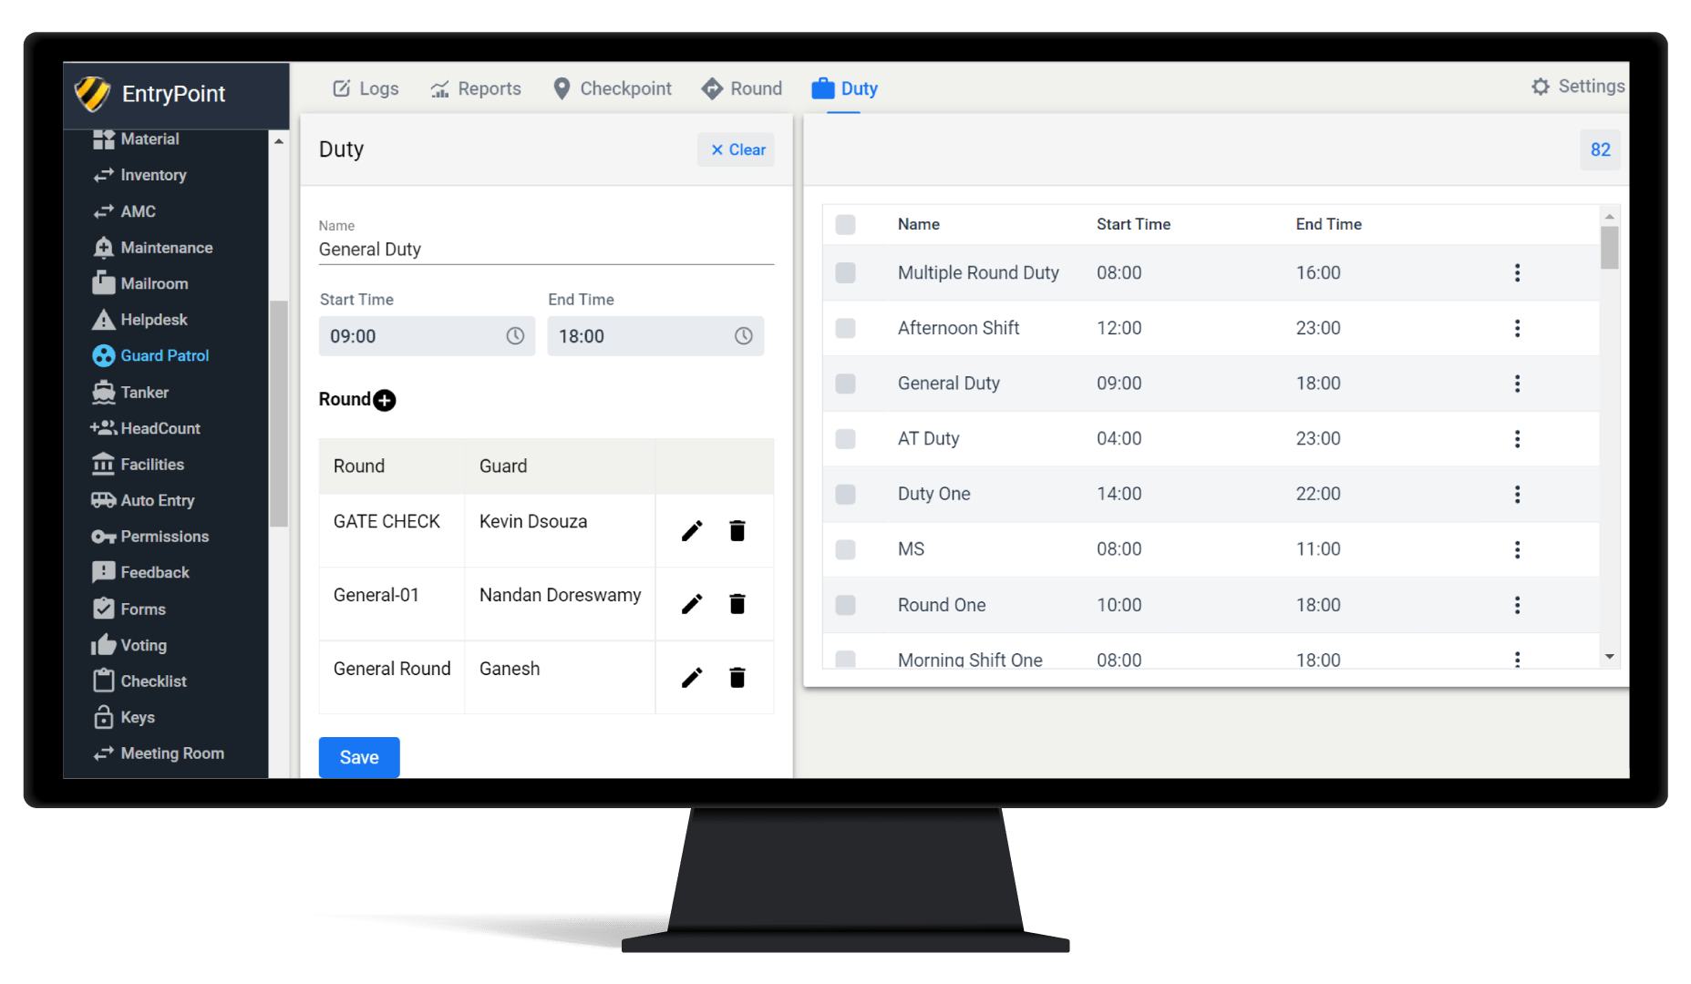
3 - Creating Duties
The Admin/Security Head can create Duties for the Guards which may include multiple different rounds assigned to different guards simultaneously. This way a batch of guards can perform unique scanning duties.

Slide 15
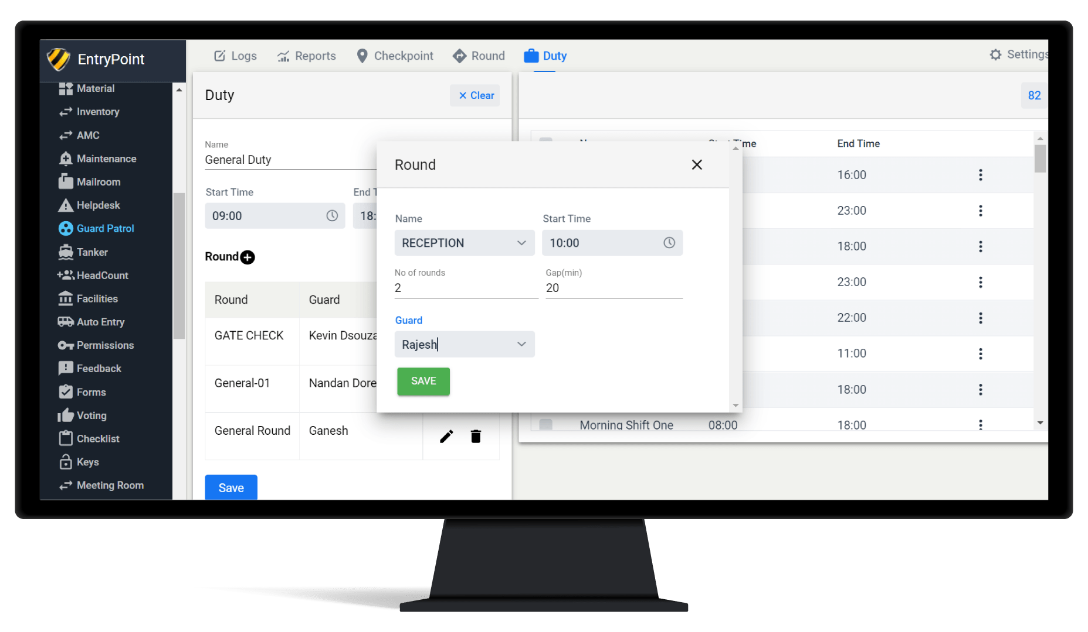
3 - Creating Duties

Slide 16
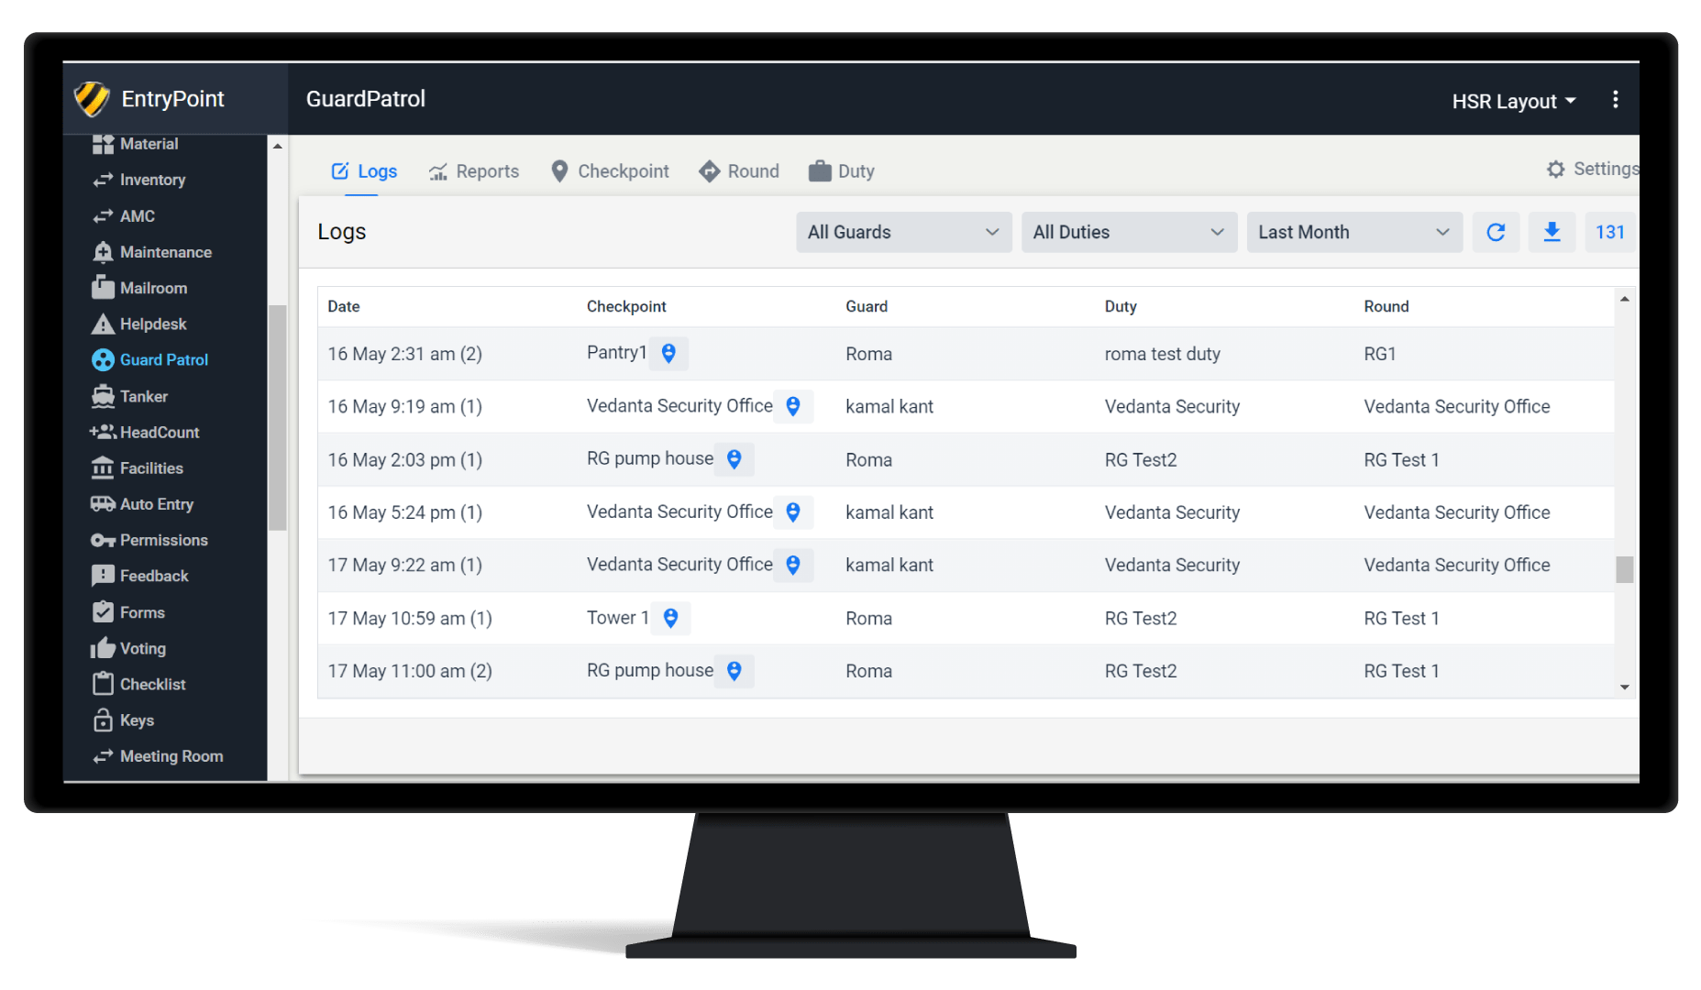
Guard Patrol Solution - Dashboard
4 - Logs
The Corporate Office members can also view the data in the Dashboard

Slide 17
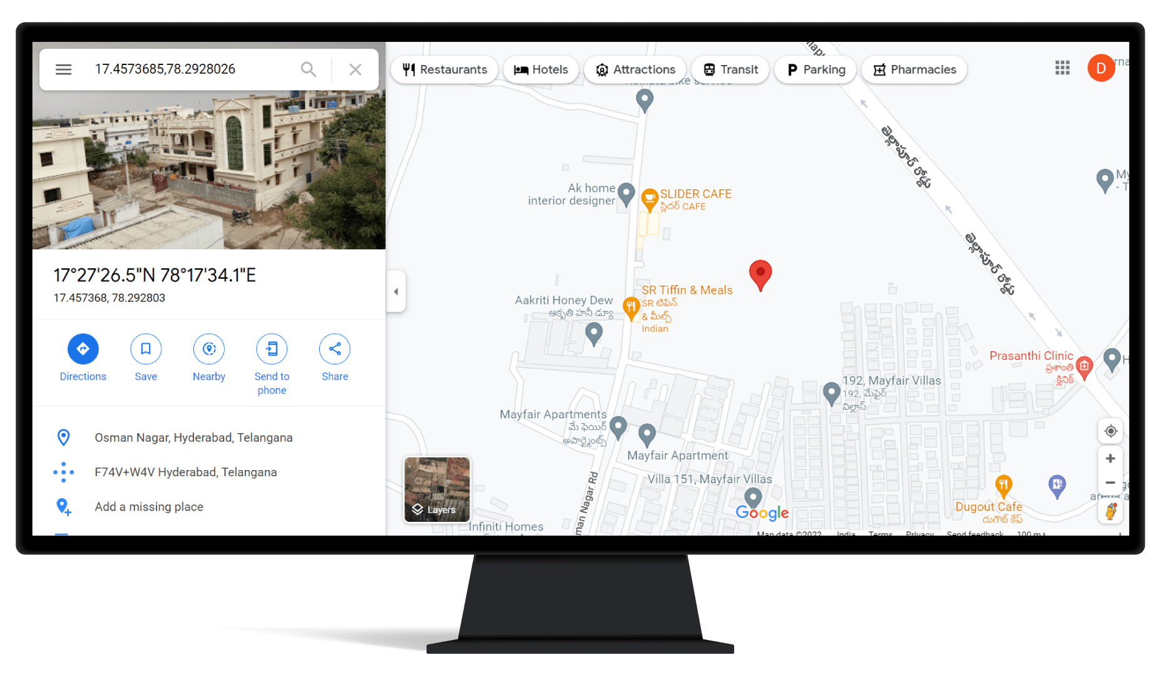
Guard Patrol Slution - Dashboard
4 - Logs
The Logs will show each and every scan that is made along with the Geolocation Tagging.
The Logs can also be filtered according to Guards, Duties and Dates.
The Data can also be downloaded in an Excel Format

Slide 18
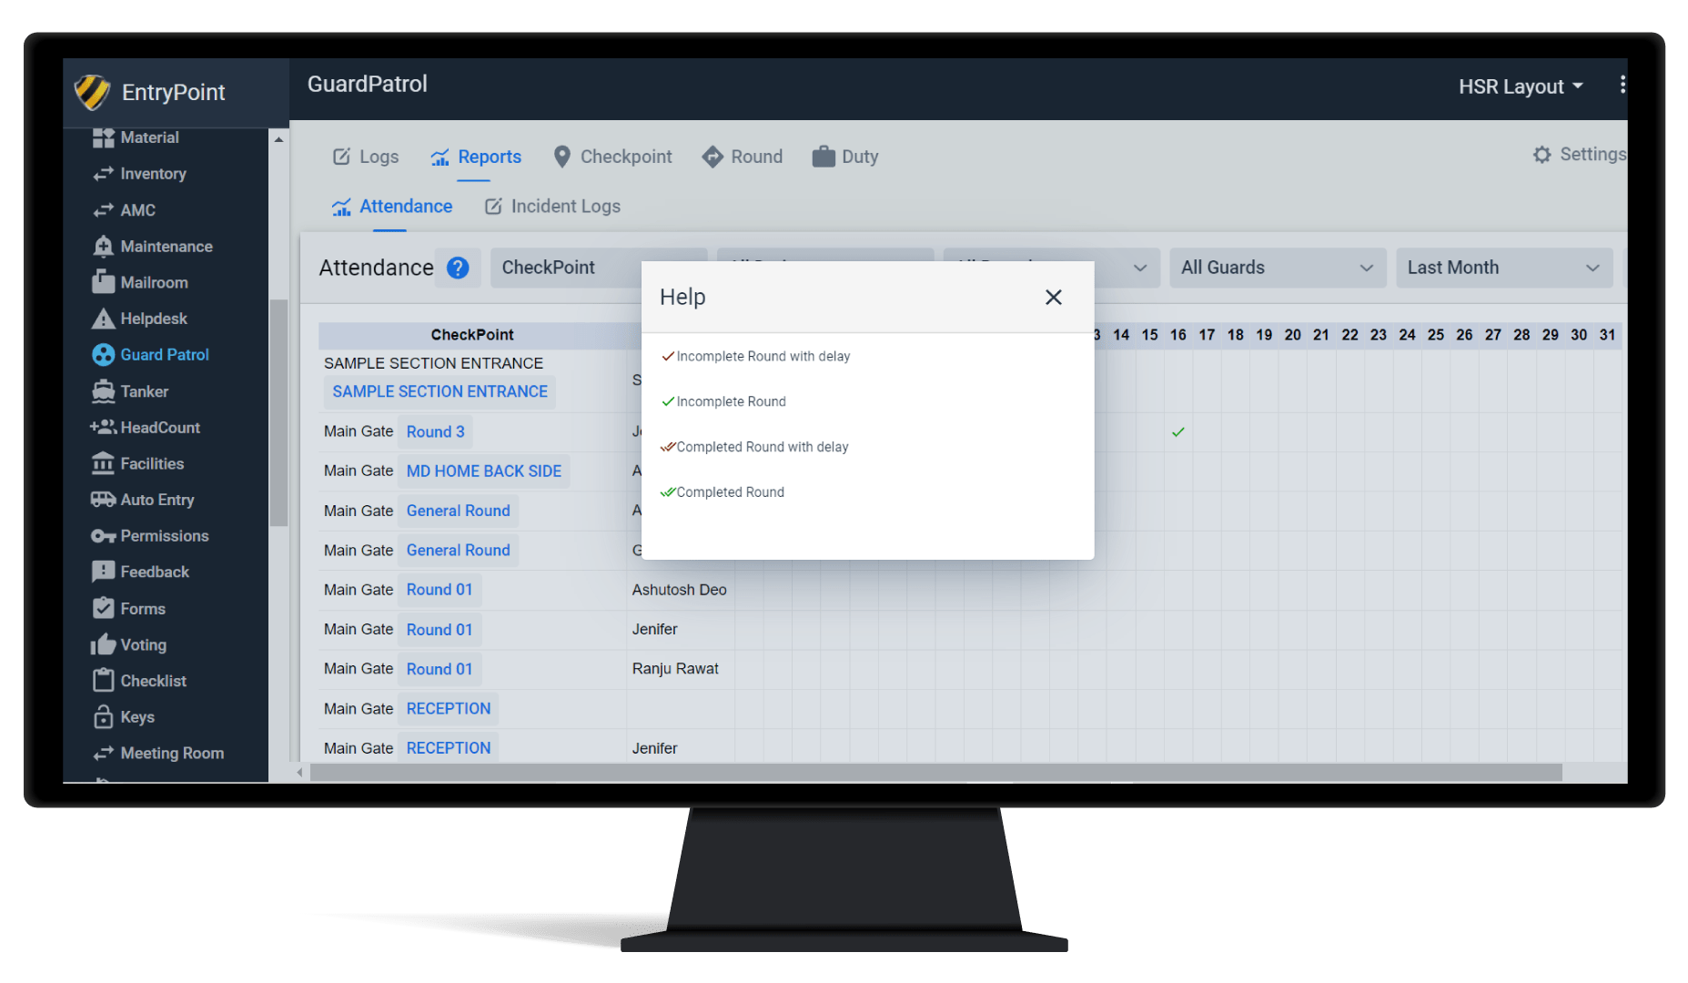
Guard Patrol Solution - Dashboard
5- Reports
The reports can be viewed from the Dashboard. The performance of the guards can be tracked according to Parameters of Completion of scans and Time.

Slide 19
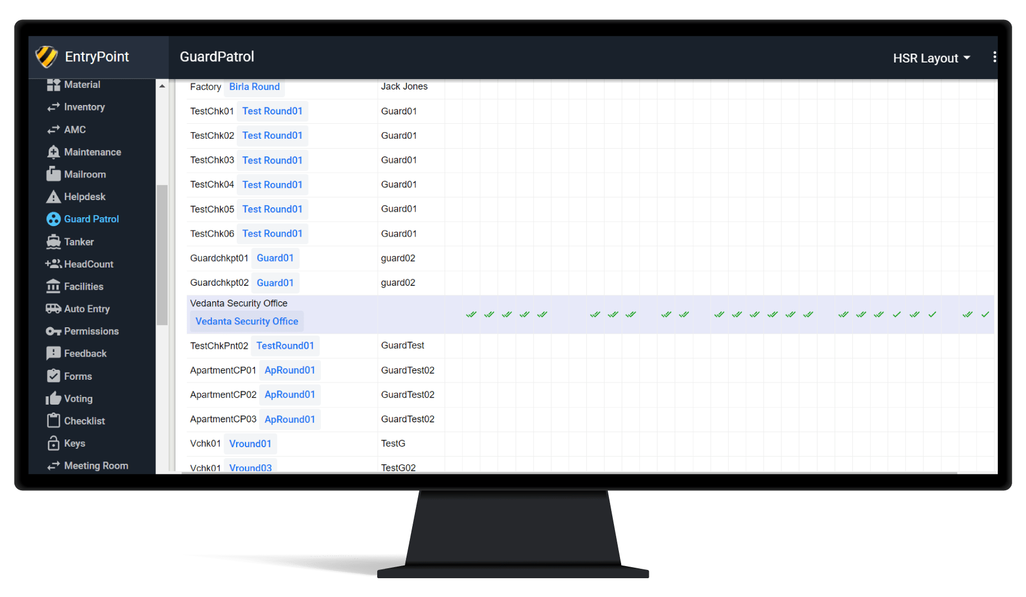
Guard Patrol Solution - Dashboard
5- Reports
The reports are presented in a calendar format with tick marks to show performance
The reports can be filtered and downloaded in an excel format as well.

Slide 20
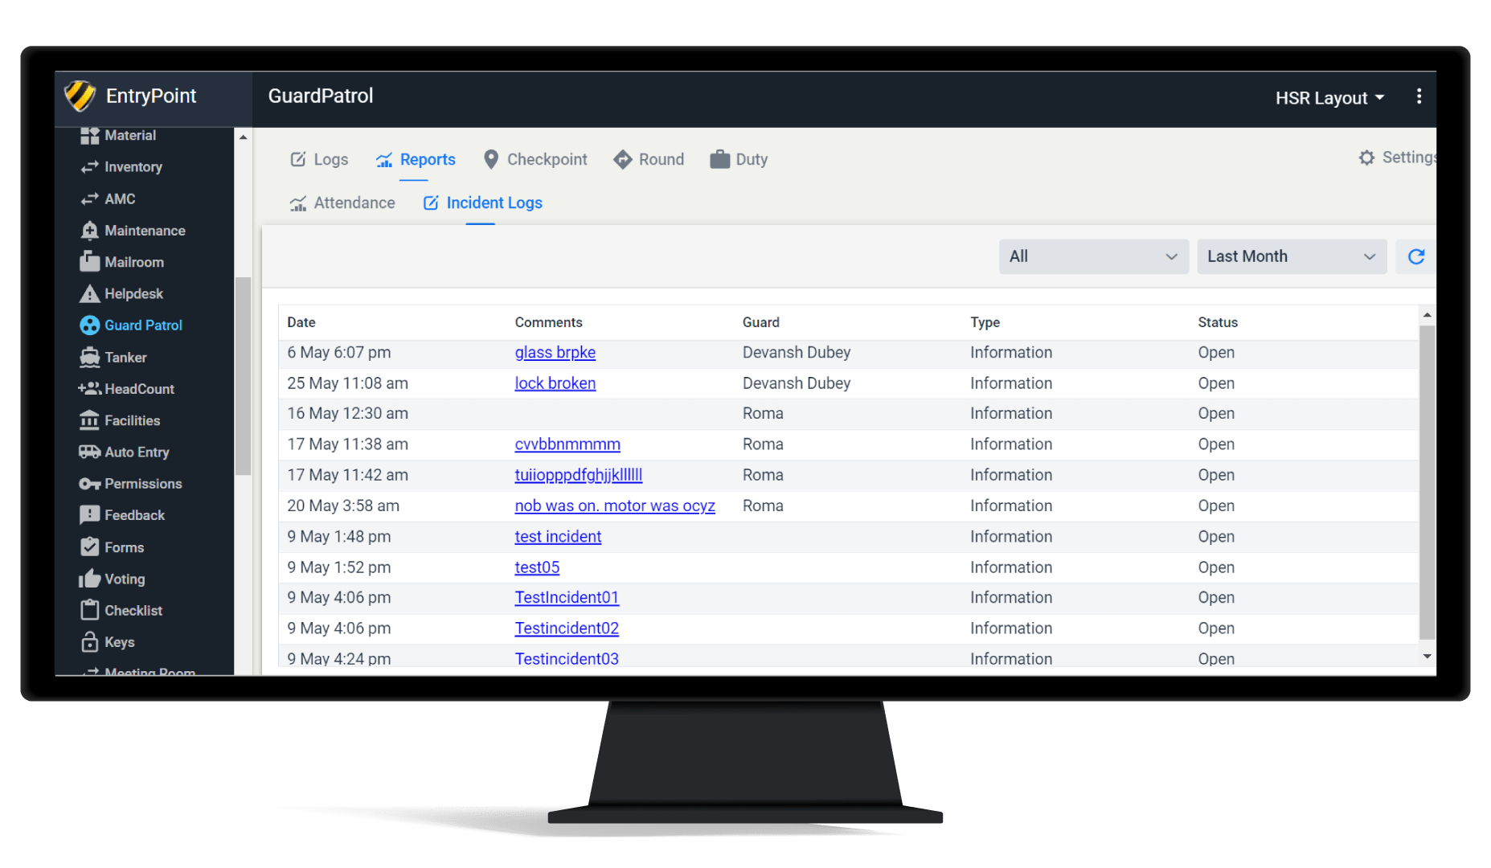
Guard Patrol Solution - Dashboard
5- Incident Reporting
The Guards can report incidents from their applications. The incidents can be viewed in the Dashboard and custom notifications can be sent to concerned stakeholders to look into the matter.

Slide 21
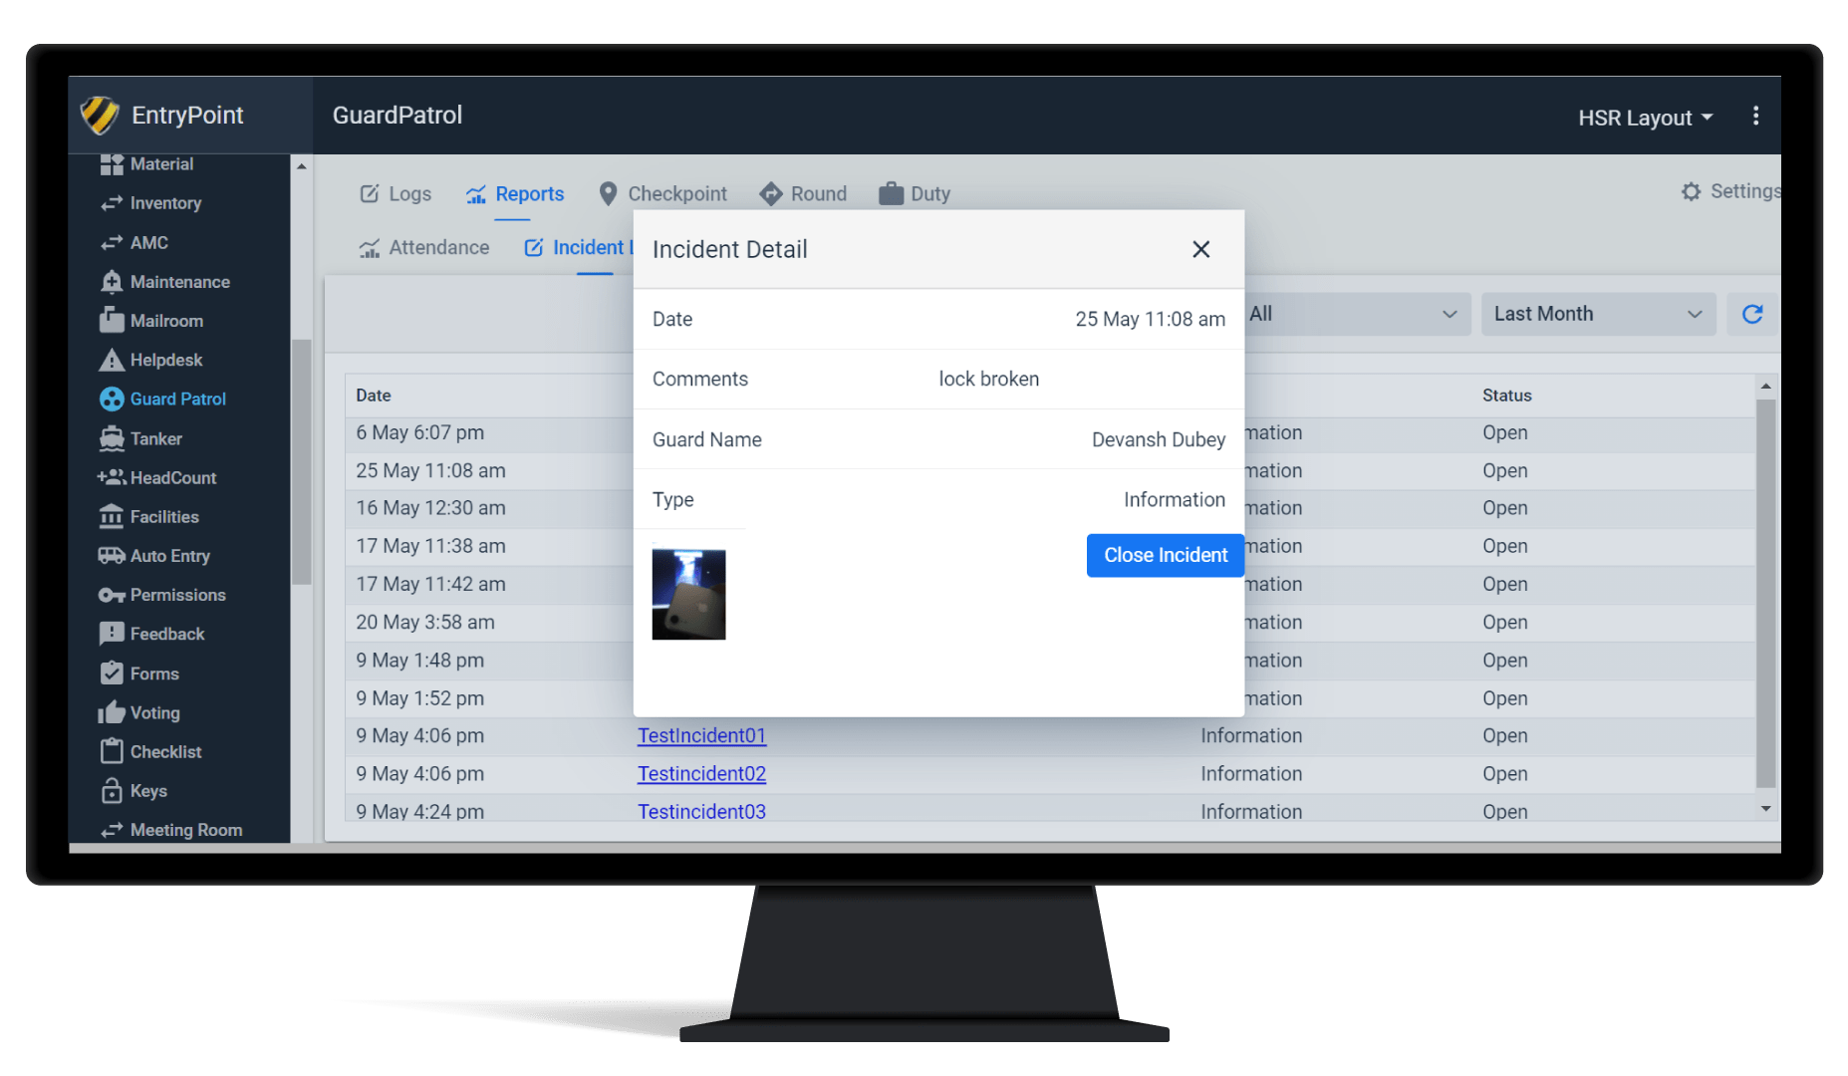
Guard Patrol Solution - Dashboard
5- Incident Reporting
The Incidents can be reported along with Images and Voice notes and can be closed when resolved

